Slide 1


Slide 2


Slide 3



Slide 4
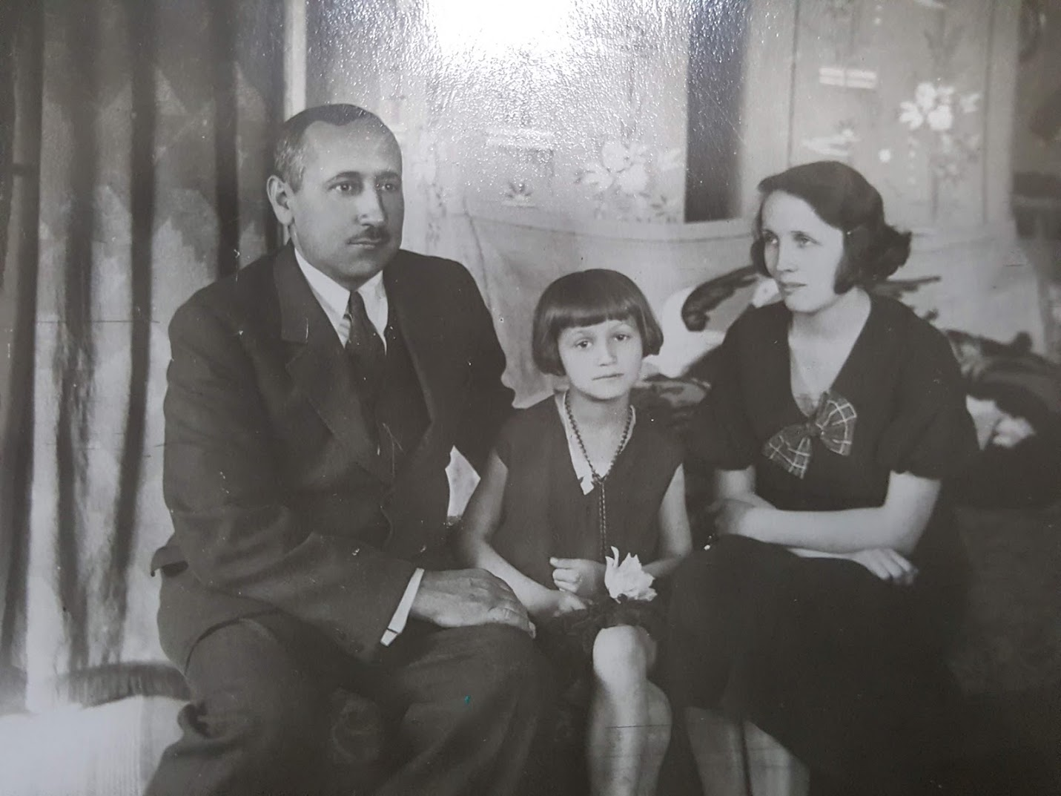
Notes:
My mother-in-law as a child

Slide 5
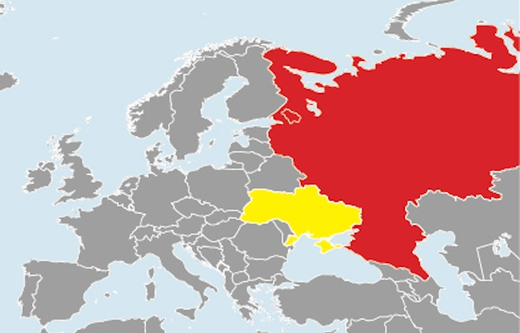

Slide 6
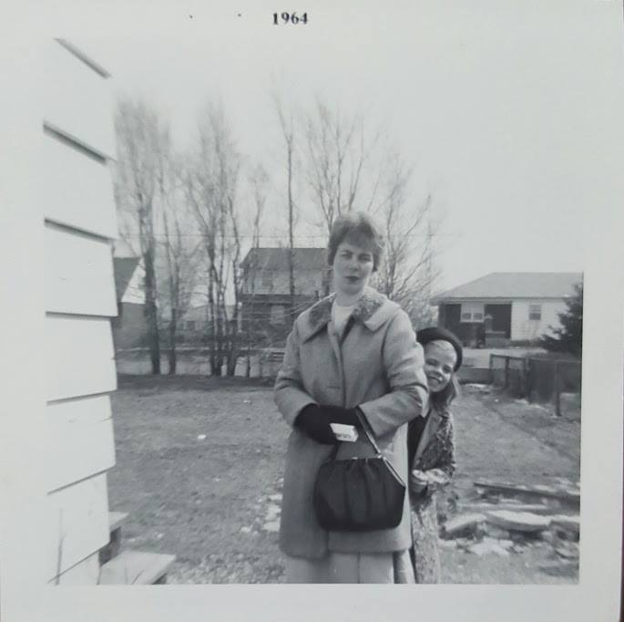

Slide 7
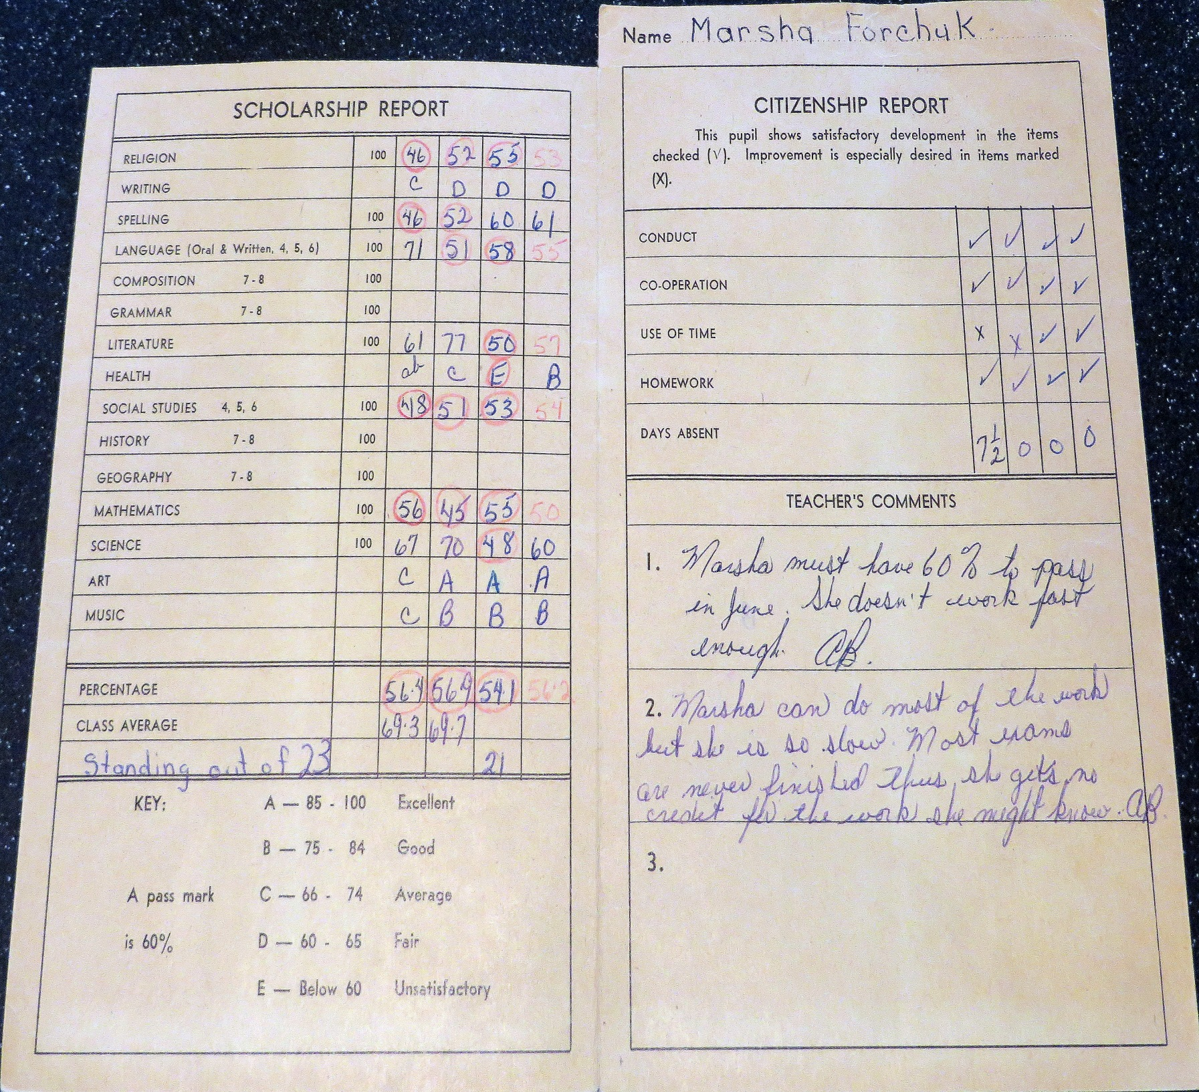
Notes:
7
Grade 4 report card

Slide 8


Slide 9


Slide 10


Slide 11


Slide 12


Slide 13
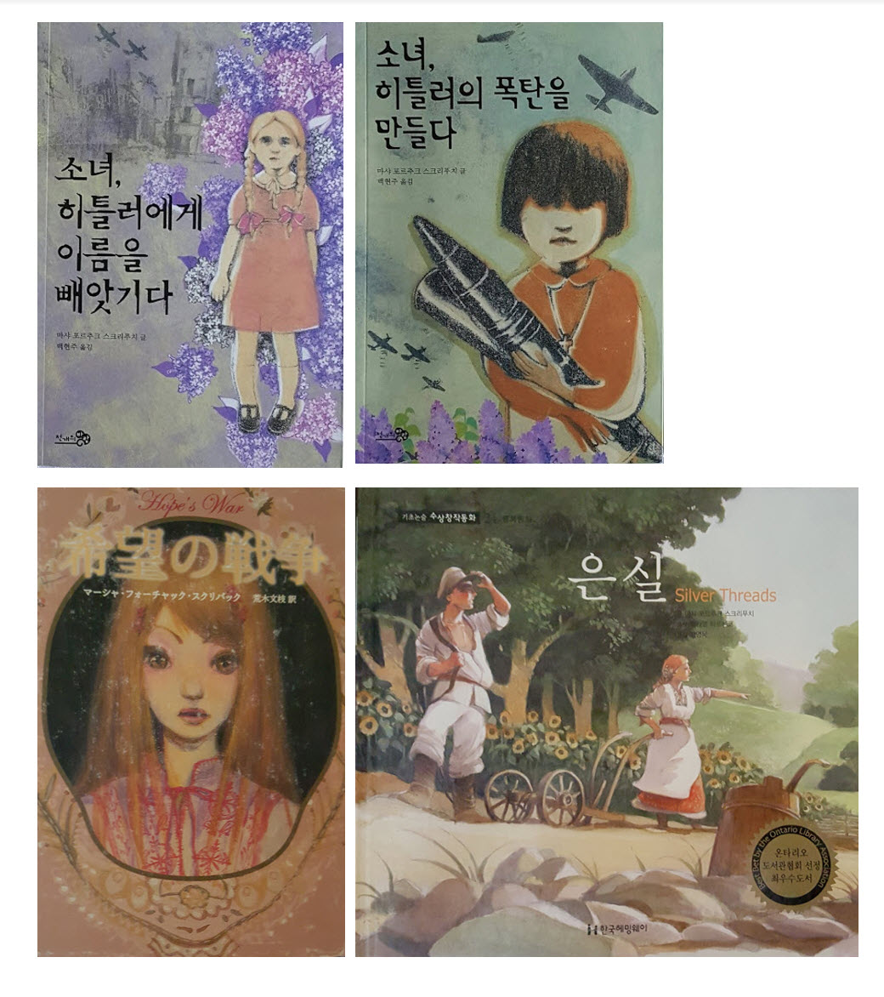


Slide 14


Slide 15


Slide 16


Slide 17


Slide 18


Slide 19


Slide 20
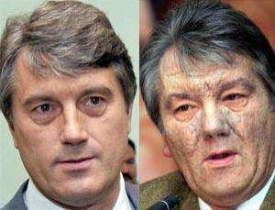

Slide 21
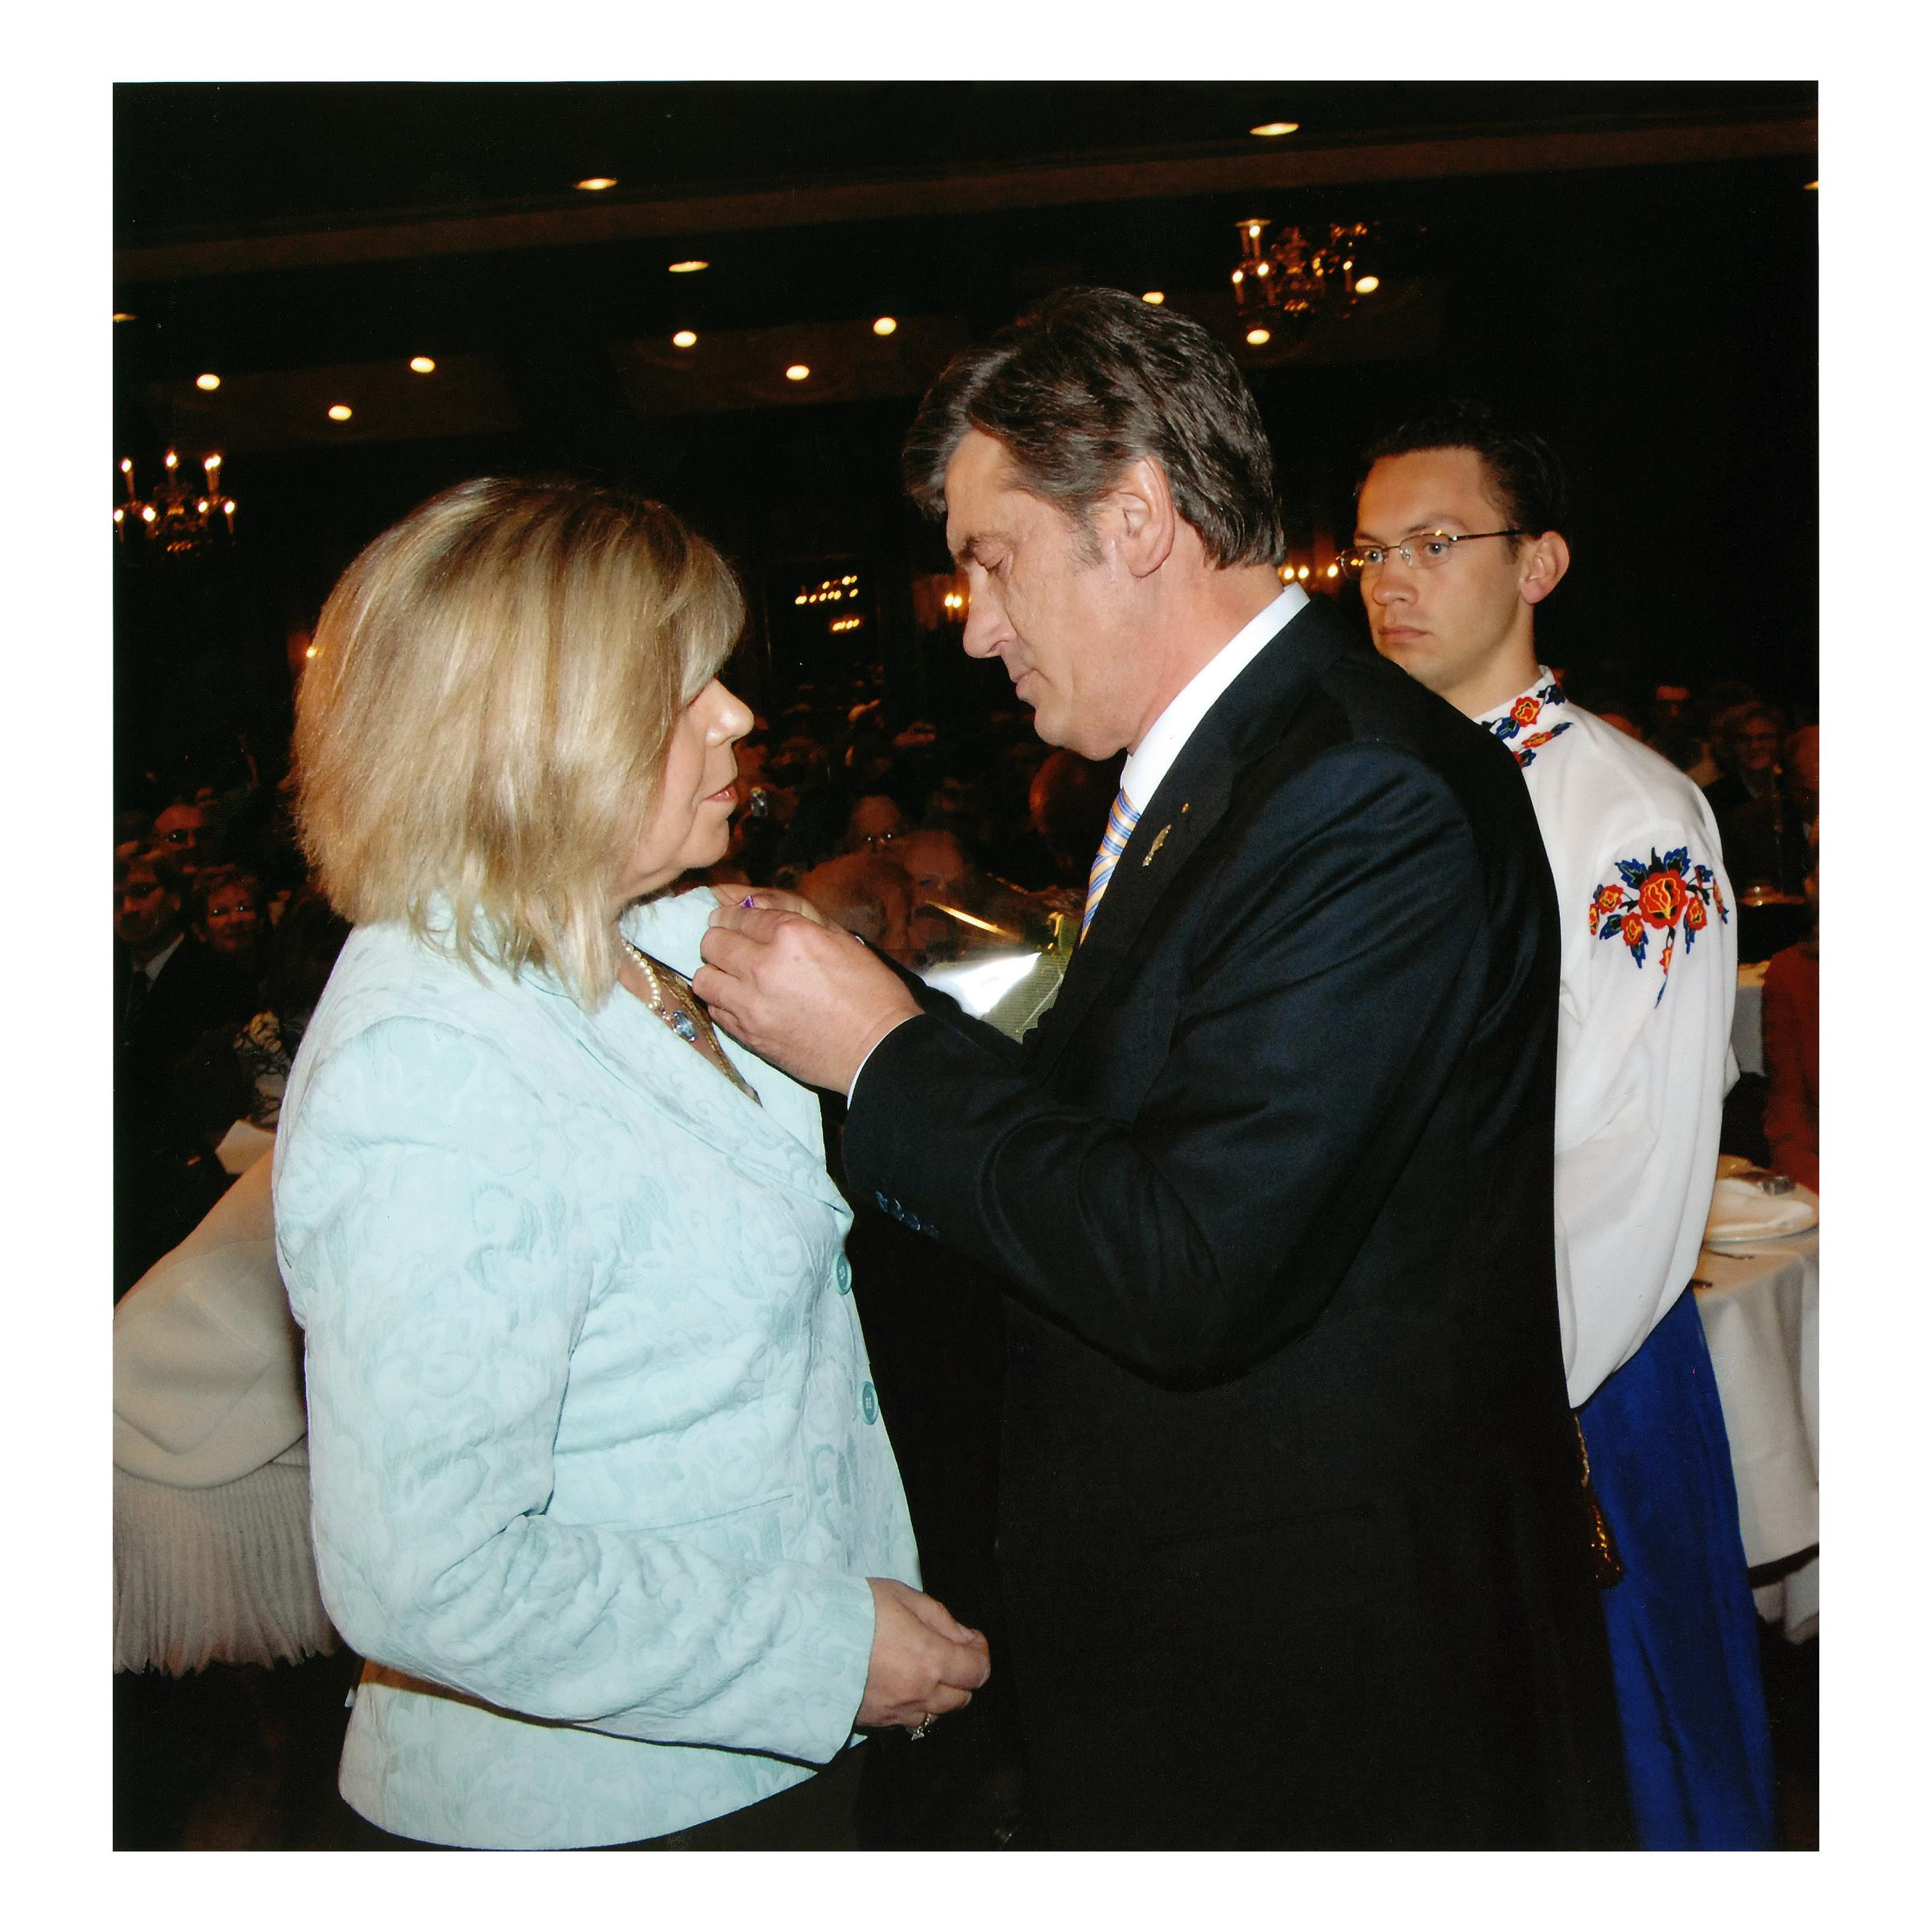

Slide 22
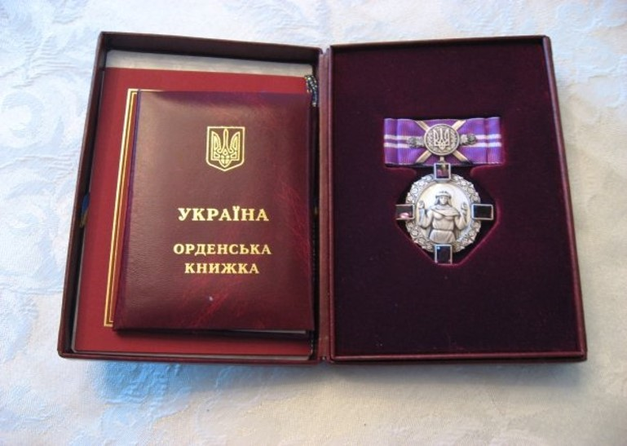

Slide 23


